Slide 1
Recommender Systems
Rajlaxmi Nehal Tanmay Alok

Slide 2
Outline
Introduction
Paradigms of Recommender Systems
Types of Collaborative Filtering
Item-based Collaborative Filtering
User-based Collaborative Filtering
Demo
Recent Research
Conclusion
References

Slide 3
What are Recommender Systems?
Recommender Systems are software agents that take into account the interests or references of individual consumers for products, either explicitly or implicitly, and make recommendations accordingly. [4]
Abstract View of Recommender Systems
Information about user preferences, product details, etc.
Recommender
System
Recommended Product

Slide 4



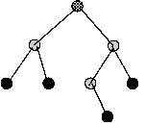
Paradigms of Recommender Systems
Content - based
User Profile Information and History
Product Features
Recommender System
Recommendation List
Knowledge - based
User Profile Information and History
Product Features
Recommender System
Recommendation List
Knowledge models

Slide 5

Paradigms of Recommender Systems
User Profile Information and History
Collaborative
Community Data
Recommender System
Recommendation List
User Profile Information and History
Hybrid
Product Features
Community Data
Recommender System
Recommendation List
Knowledge models

Slide 6
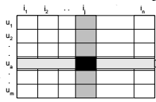
Collaborative Filtering
Recommendation of a certain item for a particular user is based on the user’s previous likings and the opinion of other like-minded users.
Users’ liking of a particular item is expressed as a ratings score.
These rating scores are represented as a ratings matrix whose i, j th entry contains the rating of ith user for the jth item.
Item j
User i
Rating Matrix

Slide 7
Techniques in Collaborative Filtering
User-based Collaborative Filtering
Recommendation list for a user is formed according to the similarity between purchased and rated items of this user and other users.
Similarity is computed along the rows of the rating matrix.
Item-based Collaborative Filtering
User’s purchased and rated items are matched with other items to generate the recommendation list
Similarity is computed along the columns of the rating matrix.

Slide 8
Item-Based Collaborative Filtering
Basic Idea
Use the similarity between items to make predictions
Two aspects of Item based Collaborative Filtering are
Similarity Computation
Recommendation Generation
User + Rating Matrix +
Similarity
Computation
Recommendation
Generation
List of recommended items for the user
User +
Rating Matrix
Similarity value between items

Slide 9
Similarity Computation
This part computes the similarity between two items, i and j, as a similarity function sim(i, j).
Similarity between two items can be computed using various similarity measures -
Cosine-based Similarity
Adjusted Cosine Similarity
Correlation Based Similarity

Slide 10
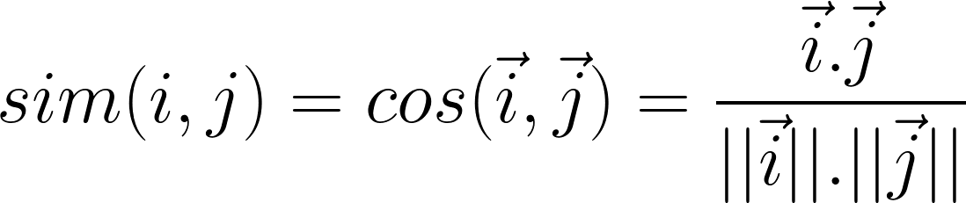
Cosine-based Similarity
In this case, the two items are thought of as two vectors in the m-dimensional user space. These two vectors are the columns for the two items in the rating matrix.
The similarity between them is measured by computing the cosine of the angle between these two vectors.
Formally, the similarity between items i and j, sim(i, j), is measured as

Slide 11
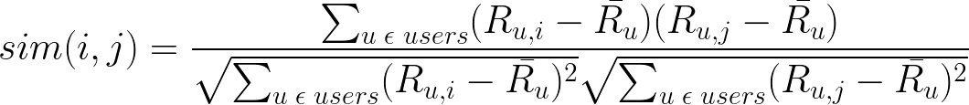
Adjusted Cosine Similarity
In cosine-based similarity, differences between rating scale of different users is not taken into account.
The adjusted cosine similarity removes this drawback by subtracting the corresponding user average from each co-rated pair.
Formally, the similarity between items i and j, sim(i, j), is measured as

Slide 12

Correlation-based Similarity
In this case, similarity between two items i and j is measured using Pearson’s correlation.
To make the correlation computation accurate, we must first isolate the cases where the users rate both i and j. Let ‘users’ define such a set of users.
Formally, the similarity between items i and j, sim(i, j), is now measured as

Slide 13
Recommendation Generation
Once we have the similarity measure, we find candidate recommendation items for a user. This is done by taking the union of most similar k items (which the user hasn’t purchased yet) for each item i that the user purchased.
Next, we compute the predicted rating for the candidate items using their similarity values with all the items the user has purchased.
The predicted rating is computed by taking the weighted sum as follows.

Slide 14

Weighted Sum
This method computes the predicted rating for the candidate item i for a user u by computing the weighted sum of the ratings given by the user on the items similar to i.
The similarity measure, sim(i,j), is used as a weight to calculate the above weighted sum. Formally, the prediction Pu,i
After getting the predicted values, N items with the highest predicted value are recommended to the user.

Slide 15
Points to Consider
Some points to note -
Content of items being recommended is not considered. Eg. Amazon mentions frequently bought together items.
Cold Start Problem
Due to insufficient data, accuracy of recommendations for new users may be poor.
Also new items may not be recommended to any user.

Slide 16
User-Based Collaborative Filtering
Basic Idea
Find a set of users similar to the given user (Neighbourhood Formation).
Generate a prediction for an item, by analyzing ratings for that item from the users in the neighborhood.
Two aspects of recommendation generation are
Neighbourhood Formation
Prediction Generation

Slide 17

Neighbourhood Formation
The main goal is to find a set of neighbours, i.e, users who have liked same items as the given user in the past.
K nearest neighbour technique is used to find similar users
Similarity between target user,u, and a neighbour,v, is calculated using any of the similarity computation method
For example: Pearson’s correlation coefficient

Slide 18

Prediction Generation
Once the neighbourhood is formed, rating for target item i can be predicted by using following formula:
where V is the set of k similar users, rv,i is the rating of user v given to item i.
After getting the predicted values, N items with the highest predicted value are recommended to the user.

Slide 19
Points to Consider
Some points to note-
Sparsity: Performance is poor when data is sparse, i.e Large number of items are present, but each user rates very less number of items.
Scalability: Nearest Neighbour algorithms require computation that grows with both users and number of items.
Cold Start Problem

Slide 20
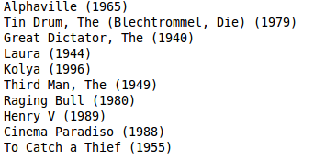
Demo
Input: Dataset is used to generate recommendation
Data: MovieLens Data set with 100,000 ratings
Output: Movies Recommended to user
Sample Recommendation Generated:

Slide 21
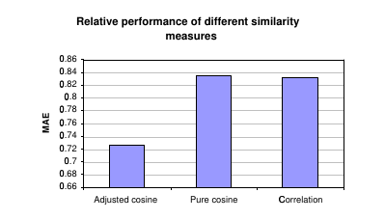
Relative Performance of Similarity Measures
Reference:
[2]

Slide 22

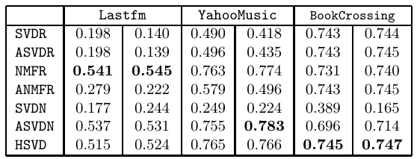
Recent Research
Matrix factorization techniques are used. For example: SVDR, ASVDR, etc.
Precisions obtained by these method is calculated as follows :
Where Yt is the subset of new users, is set of items liked by user yi and Ri is set of items recommended using above techniques.
Results [6]:

Slide 23
Conclusion
Recommender systems are a powerful new technology for extracting additional value for a business from its user databases.
Popular techniques for recommender systems include User-based and Item-based collaborative filtering.
Recommender systems face the problem of scalability due to increasing volume of user data available. New technologies are needed to face the problem of scalability.
The cold start problem is common to both User-based and Item-based collaborative filtering. It can be reduced by adopting a hybrid approach between content-based matching and collaborative filtering.

Slide 24
References
[1] G. Linden, B. Smith, and J. York, “Amazon.com Recommendations Item-to-Item Collaborative Filtering”, in IEEE Internet Computing, IEEE Computer Society, 76-80, Jan. 2003.
[2] B. Sarwar, G. Karypis, J. Konstan, and J. Riedl, “Item-Based Collaborative Filtering Recommendation Algorithms”, in World Wide Web Conference, ACM 1-58113-348-0, May 2001.
[3] G. Karypis, “Evaluation of Item-Based Top-N Recommendation Algorithms”, in Conference on Information and Knowledge Management, Oct. 2001.
[4] B.Xiao and I. Benbasat, “E-Commerce Product Recommendation Agents”, MIS Quarterly Vol. 31 No. 1, pp. 137-209, Mar. 2007.
[5] F Ricci, L. Rokach,B. Shapira and P. Kantor, “Recommender Systems Handbook”, Springer Science plus Business Media, 2011.
[6] L. Pu and B. Faltings, “Understanding and Improving Relational Matrix
Factorization in Recommender Systems”, in RecSys 2013, 7th ACM Conference, 41-48, Oct. 2013.

Slide 25
Questions?

Slide 26
Thank you.

